Slide 1
IoT-BASED REAL-TIME WORKSHOP TRANSPARENCY
Smart PPF Workshop
Monitoring System
See Your Car. Track Progress. Trust the Process.
Real-Time Streaming
Secure Access
Live Analytics

Slide 2
THE CHALLENGE
Workshop Owner Challenges
The Problem:
Lack of Transparency
Constant Interruptions: Customers call every 30 minutes for status updates
Pricing Pressure: Cannot justify premium pricing without transparency proof
Customer Loss: Losing clients to competitors with better communication
Staff Overhead: 20% of staff time spent answering "when will it be done?"
Customer Pain Points
No visibility into car's status during modification process
Anxiety about work quality and technician expertise
Unclear estimated completion times and progress updates
4-6 Hours
of waiting without visibility into car status

Slide 3
THE SOLUTION
Real-Time Workshop Monitoring
IoT-powered transparency that transforms customer experience and workshop operations
Customer Device
Environment
Phone / Laptop / Tablet
Monitor temperature, humidity, air quality
Secure Connection
Live Video
Secure Access
Watch your car in real-time from anywhere
Cloud Platform
Login-based customer portal protection
Live Stream + Data
Workshop Pit
Progress
Car + Camera + Sensors
Track job status with estimated completion
Wired Connection

Slide 4
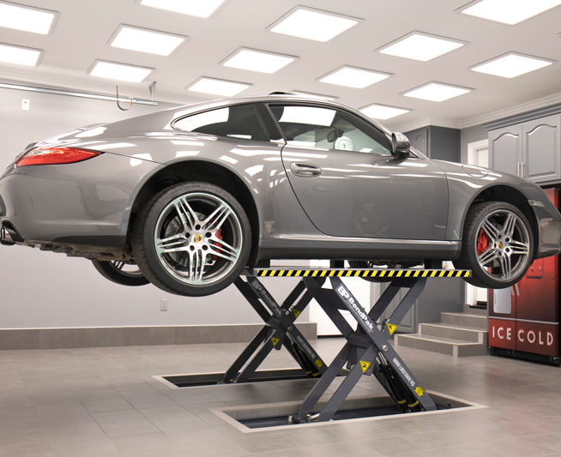
SYSTEM OVERVIEW
How It Works
Temperature
24.5°C
Hikvision IP Camera
ESP32 + BME680
1080p Live Streaming
Environmental Sensors
Humidity
55%
78
Air Quality
Good
Status
PPF Installation
Time Remaining
2h 15m
PoE Connection
Reliable Wired Network

Slide 5
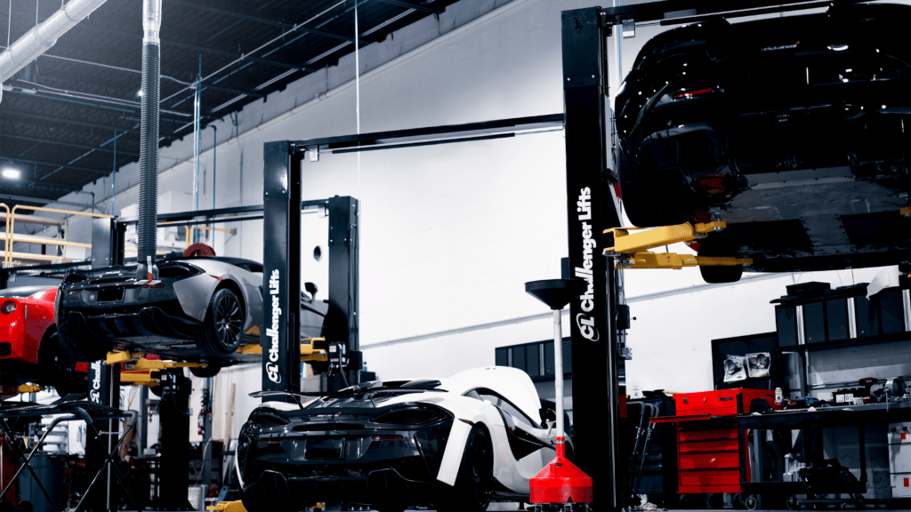
CUSTOMER EXPERIENCE
Mobile Portal Access
Your Car
LIVE
Live HD Video
Pit 2 - BMW X5
See your car anytime, anywhere with crystal-clear streaming
Key Benefits
Real-Time Data
24/7 Access
Environmental conditions monitored continuously
Real-Time Updates
Secure Login
Progress Updates
24.5°
55%
78
Temp
Humidity
AQI
Mobile Optimized
Know exactly when to arrive with live countdown
Instant Notifications
Status
In Progress
Peace of Mind
PPF Installation
60% Complete
2h 15m left
No more anxious waiting with full transparency
Estimated Completion
Today, 4:30 PM

Slide 6
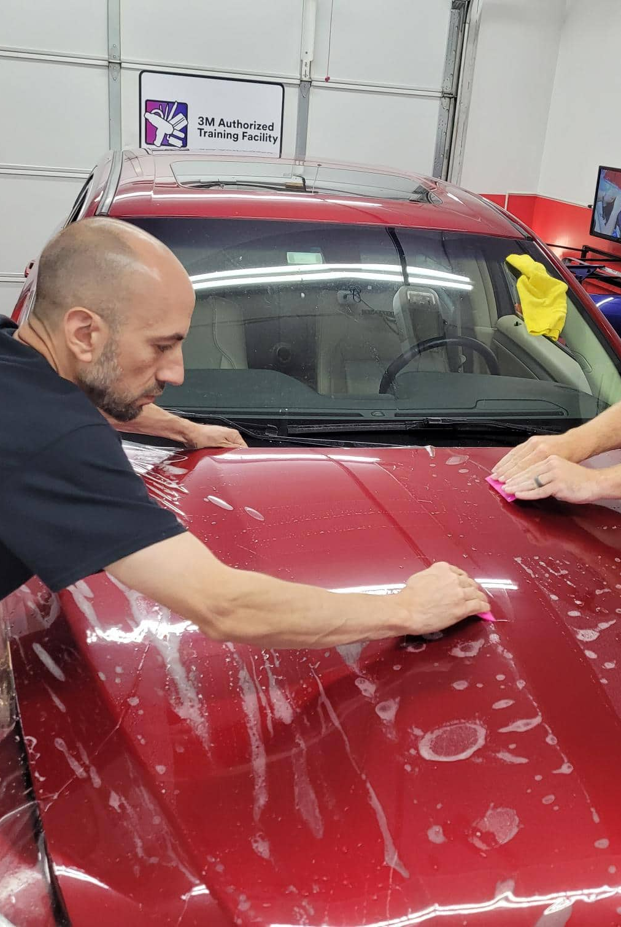
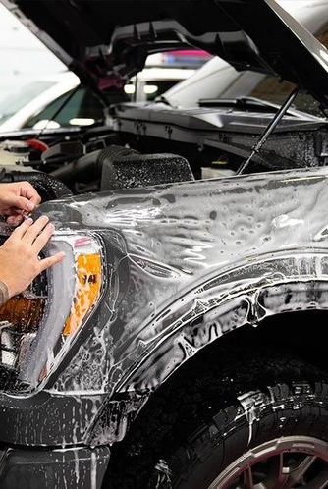
OWNER DASHBOARD
Command Center
Multi-Pit Overview
3 Active
2 Available
Features
Active
Active
Quality Check
Job Management
Pit 1
Pit 2
Pit 3
Create, edit, track all jobs
Multi-User Access
Manage staff permissions
Analytics
Historical data & trends
Smart Alerts
Instant notifications
Quick Stats
Honda Civic - Rajesh K.
BMW X5 - Priya M.
Audi A4 - Amit S.
Active Jobs
3
23°
52%
65
24°
55%
78
25°
58%
82
Staff Online
5
Temp
Hum
AQI
Temp
Hum
AQI
Temp
Hum
AQI
Time Left:
45m
Time Left:
2h 15m
Time Left:
15m
Alerts
0

Slide 7
TECHNICAL ARCHITECTURE
System Architecture
Workshop
Cloud
Users
Cameras, Sensors, Network
Video Server, Database, API
Owner Dashboard, Customer Portal

Slide 8
DATA FLOW
End-to-End Process
From sensor to screen in under 2 seconds
1
2
3
4
5
ESP32 Sends to Cloud
Cloud Processes
Real-Time Update
User Sees Live Data
Sensor Reads Data
ESP32 gateway transmits data via MQTT protocol over secure VPN tunnel
Data stored in PostgreSQL database with license key validation for security
WebSocket pushes updates instantly to Owner and Customer dashboards
Customer sees updated temperature, humidity, and AQI instantly on their device
BME680 measures temperature, humidity, and AQI every 10 seconds with precision accuracy
Every 10s
MQTT + VPN
Store + Validate
WebSocket
Instant View
Total Latency: < 2 Seconds
From sensor read to dashboard update

Slide 9
TECHNOLOGY STACK
Production-Grade Stack
Backend
Frontend
FastAPI
PostgreSQL
React
Tailwind CSS
Python Web Framework
Relational Database
UI Framework
Styling
Mosquitto
MediaMTX
Socket.IO
Video.js
MQTT Broker
Video Streaming
Real-Time Comms
Video Player
Nginx
Reverse Proxy + SSL
Hardware/IoT
Cloud Hosting
ESP32
BME680
Hikvision
DigitalOcean
AWS
Linode
Microcontroller
Sensor
Camera
Cloud VM
Storage
Alternative
Production-grade, scalable, secure technology stack ready for enterprise deployment

Slide 10
HARDWARE COMPONENTS
Per-Pit Monitoring Kit
Complete plug-and-play solution
IP Camera
IoT Gateway
Hikvision DS-2CD1323G0E-I
Olimex ESP32-GATEWAY-EA
2MP (1080p) Resolution
ESP32 Microcontroller
Night Vision IR
Ethernet Port
PoE Powered
Industrial Enclosure
RTSP Streaming
OTA Updates
Unit Price
₹3,500
Unit Price
₹2,800
Environmental Sensor
Accessories Kit
Bosch BME680 Module
Cables + Mounting Hardware
Temperature Monitoring
Cat6 Ethernet Cables (10m + 5m)
Humidity Detection
Camera Mounting Bracket
Pressure Sensing
Installation Screws & Anchors
Air Quality (IAQ/VOC)
I2C Jumper Wires
Unit Price
₹800
Unit Price
₹650
Complete Pit Kit Total
₹7,750
Everything needed for one monitoring pit
~$93 USD per pit

Slide 11
INFRASTRUCTURE
Workshop Setup Requirements
One-time infrastructure investment
PoE Switch
VPN Router
Installation
TP-Link TL-SG1005P
TP-Link Archer C6
Materials + Labor
5-Port Gigabit
Dual-Band AC1200
Cat6 Cables
PoE+ (802.3at)
VPN Client Ready
Cable Management
56W Power Budget
4× Gigabit Ports
4-6 Hours Labor
Price
₹2,500
Price
₹2,000
Price
₹3,500
Total Workshop Setup
₹8,000
One-time cost for 3-pit workshop
~$95 USD
Note for 3+ Pits
Professional Installation
Use 8-port PoE switch (₹4,500 instead of ₹2,500)
Certified technician ensures optimal setup

Slide 12
PRICING & BUSINESS MODEL
Investment Breakdown
Hardware
Subscription
First Year
1 Pit Kit
₹7,750
Per Pit / Month
₹1,500
Hardware
₹31,250
3 Pit Kits
₹23,250
3 Pits / Month
₹4,500
Subscription
₹54,000
Workshop Setup
₹8,000
12 Months
₹54,000
Year 2+ Cost
₹54,000/yr
Total (3 pits)
₹31,250
Annual Cost
₹54,000
Grand Total
₹85,250
One-time payment
Recurring revenue
First year investment
Value Proposition
6 Months
Justify 15-20% premium pricing with transparency → ROI in 6 months
to ROI

Slide 13
OWNER BENEFITS
Complete Control Dashboard
Job Management
Live Monitoring
Smart Alerts
Create jobs with car details
View all pits simultaneously
High AQI → SMS alert
Assign pits and staff
Full-screen mode per pit
Camera offline → Dashboard
Set/modify completion times
Real-time sensor overlay
Temperature alerts
Work type templates
Staff activity tracking
Twilio SMS integration
Multi-User
Analytics
Communication
Add staff/operator accounts
Average job duration
Auto-generate credentials
Role-based permissions
Environmental trends
SMS notifications
Activity logs
Peak usage hours
Post-job feedback
Pit access control
Customer ratings
WhatsApp integration
Complete workshop management from a single dashboard

Slide 14

CUSTOMER BENEFITS
Peace of Mind Experience
Transparency
Trust Building
See your car anytime during modification
Visual proof of work in progress
No more wondering "what's happening?"
Demonstrates workshop professionalism
Peace of Mind
Convenience
Real-time environmental monitoring
Access from anywhere (home, office, on go)
Professional conditions verified
Simple login via WhatsApp/SMS
Time Savings
Customer Satisfaction
Live countdown timer
Arrive exactly when car is ready
90%+ positive feedback on transparency

Slide 15
SECURITY & RELIABILITY
Enterprise-Grade Protection
Encrypted Connection
Access Control
VPN tunnel between workshop and cloud
JWT token authentication system
TLS 1.3 for all web traffic encryption
Role-based permissions (Owner/Staff/Customer)
No public IPs exposed to internet
Customer sees ONLY their assigned pit
Data Protection
License Management
Daily database backups to cloud storage
Each device has unique license key
Video recordings encrypted at rest (AES-256)
Remote kill-switch for non-payment
GDPR/privacy compliance ready
Subscription validation on every transmission
High Availability
Video Retention
99.9% uptime SLA (managed cloud hosting)
7-day recording storage (configurable)
Automatic service restart on failure
Option to download important footage
VPN auto-reconnect capability
Automatic cleanup to manage costs

Slide 16
DEPLOYMENT TIMELINE
14 Weeks to Production
P1
Phase 1: MVP (Single Pit Demo)
6 Weeks
Week 1-2
Week 3
Week 4
Backend + Cloud Setup
ESP32 Firmware
Video Streaming
Week 5
Week 6
Frontend Dashboard
Testing + Demo to Client
Deliverable: Fully functional 1-pit system
P2
Phase 2: Production (3 Pits)
4 Weeks
Week 7-8
Week 9
Week 10
Multi-Pit Scaling
Hardware Deployment
Production Hardening
Deliverable: 3-pit workshop fully operational
P3
Phase 3: Franchise Ready
4 Weeks
Week 11-12
Week 13
Week 14
Multi-Tenancy
Billing Automation
Documentation
Deliverable: Plug-and-play expansion kit
Total Timeline: 14 Weeks
From start to franchise-ready system

Slide 17
SCALABILITY
Unlimited Growth Potential
Start small, scale without limits
1
3
10
50+
Single Pit
Workshop
Multi-Location
Enterprise
MVP / Demo
Full Setup
Franchise
Chain
₹7,750 hardware
₹23,250 hardware
₹77,500 hardware
Custom pricing
₹1,500 /month
₹4,500 /month
₹15,000 /month
Volume discount
Proof of concept
Full transparency
2-3 locations
Chain across India
Each Pit is Identical. Plug and Play. No Limits.
∞
Cloud architecture handles 100+ workshops on single server
Scalability

Slide 18
FRANCHISE MODEL
Rapid Expansion Framework
New workshop operational in 3-5 days
1
New Workshop Signup
Fill online form → Receive quote based on pit count
2
Order Hardware Kits
Pre-configured ESP32s shipped with cameras & accessories
Delhi
Mumbai
3
Remote Setup (24h)
VPN credentials via email → Video call assistance → Remote testing
Bangalore
Chennai
4
Go Live
Owner dashboard training → Create first job → System operational
Timeline: 3-5 Days
Hyderabad
Pune
From signup to fully operational
24/7 Support
Remote monitoring + WhatsApp support

Slide 19
COMPETITIVE ADVANTAGES
Why Our System Wins
Feature | Our System | Traditional CCTV | Manual Updates
Customer Access | Live + Login | Owner Only | None
Environmental Data | Real-time | No Sensors | Manual
Job Tracking | Automated | None | Phone Calls
Scalability | Unlimited | Limited | N/A
Remote Management | Cloud | Local Only | N/A
Business Model | Recurring | One-time | N/A
Installation Time | 4-6 Hours | 2-3 Days | N/A
Only IoT Solution Built Specifically for PPF/Car Modification Workshops

Slide 20
FUTURE ROADMAP
Innovation Pipeline
Becoming the operating system for automotive workshops
Enhanced Analytics
Mobile App
Q3 2026
Q4 2026
Workshop activity heatmaps
Native iOS + Android apps
AI-based predictive job duration
Push notifications
Revenue tracking & ROI dashboards
Time-lapse video generation
Staff performance leaderboards
In-app customer reviews
AI Features
Integration Ecosystem
2027
2027
Automated quality inspection (CV)
CRM integration (HubSpot, Zoho)
Face detection (staff attendance)
Payment gateway (Razorpay)
Safety compliance monitoring
Online booking system
Car damage detection
Google Calendar sync
Vision: Become the Operating System for Automotive Workshops

Slide 21
CALL TO ACTION
Transform Your Workshop
Start with 1 pit. Scale to unlimited. Justify premium pricing with real-time transparency.
Demo Request
Get Quote
Pilot Program
See it in action with a live demonstration
Custom pricing based on your pit count
Try 1 pit for 30 days risk-free
Book 30-Min Demo
Request Quote
Start Pilot
Email
WhatsApp
Website
info@ppf-monitoring.com
+91-XXXXX-XXXXX
www.ppf-monitoring.com

Slide 22
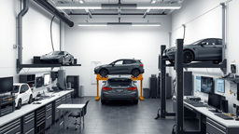
Thank You
Questions?
Email
WhatsApp
Website
info@ppf-monitoring.com
+91-XXXXX-XXXXX
www.ppf-monitoring.com
Enterprise Security
24/7 Support
Unlimited Scale

